Slide 1
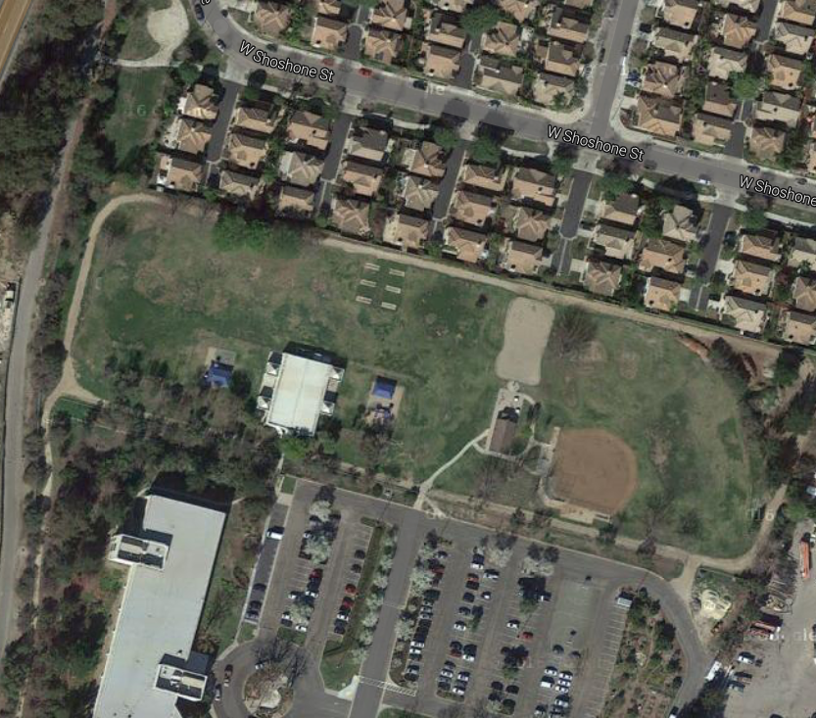
Start/Finish
BLACK LINE IS START AND FINISH LINE
FOLLOW ORANGE ARROWS X 2
BLUE ARROW TO FINISH ON SECOND LAP
VUSD Elementary 1 Mile XC Course

